Slide 1
Distributed Systems
Edited/Reviewed By: Dr. Anas Youssef
Email: anas.youssef@ci.menofia.edu.eg

Slide 2
Characterization and Models of Distributed Systems

Slide 3
Introduction
Define characterization and models of distributed systems and discuss challenges in designing distributed systems.
Explain different architectural models related to the architecture of the distributed system.
Explain fundamental models related to interaction, failure and security concerns.
Explain design requirements that reserve performance, quality and dependability.
Discuss a client-server system for banking system as an example.

Slide 4
Objectives
Students will have deeper understanding of the Challenges in distributed systems and the different models related to the architecture of the distributed system , fundamentals models and design requirements.
Students will have deeper understanding of how to design a distributed system that provides best performance , quality and security

Slide 5
List of topics
Topic # | Topic
Topic 1 | Challenges in Distributed Systems
Topic 2 | Architectural Models
Topic 3 | Case Study: Client-Server System for Banking
Topic 4 | Fundamental Models
Topic 5 | Design Requirements

Slide 6
Topic 1
Challenges in Distributed Systems
Material from:
Distributed Systems: Concepts and Design, 5th edition. Coulouris, et. Al
Prof. Bill Nace’ http://ece842.com/S13/
Dr. Rajkumar Buyya, http://www.cloudbus.org/652

Slide 7
Topic 1: Challenges in Distributed Systems
Concurrency
Heterogeneity
Openness
Security
Scalability
Failure handling
Transparency

Slide 8
Challenges : Concurrency
Single processor:
Multi threaded programming
Concurrency: non real
Jobs : Parallel cooperating threads
Execution: interleaved
Communicate: via shared memory
Clock: single
=> events can be ordered

Slide 9
Challenges : Concurrency
Multiprocessor:
Parallel computing
Concurrency: real
Job: execution of one program
Execution : cooperating threads
Communicate: via shared memory
Clock: single
events can be ordered

Slide 10
Challenges : Concurrency
Multiprocessor/Multicomputer:
Distributed computing
Concurrency: real
Job: execution of many remote procedures
Execution: cooperating many remote tasks
Communicate: via message passing or remote invocation
Clock: multiple
=> only partial order for events

Slide 11
Parallel versus Distributed System
 | Parallel | Distributed
Hardware | Identical processors Regular interconnection | Different types of processors Networks
Memory | Shared memory | Distributed memory
Control | Synchronized (global clock) | Synchronized execution of tasks (no global clock)
Main focus | Performance | Information/Resource sharing Reliability/Availability Security ….
Task Homogeneity | Tasks perform similar functions | Heterogeneous, tasks perform different functions

Slide 12
Challenges : Heterogeneity
Distributed systems are developed to work on many different kinds of software and hardware.
Heterogeneity levels:
Network: different kinds of software and hardware
Operating systems: different APIs to Internet access
Programming languages: different programming languages
Data: different representations of data
Hardware: Different processors and memory capacity
Data structures: implementations by different developers

Slide 13
Challenges : Heterogeneity
Heterogeneity (Solution)
Middleware layer:
software layer that provides a programming abstraction as well as masking the heterogeneity of the underlying networks, hardware, operating systems and programming languages.

Slide 14
Challenges : Openness
Open system:
enables interacting with services from other open systems, independent of the underlying environment
enables adding system extensions without disruption or duplication of existing services.
How?
Uniform communication mechanism
Standard published well-defined interfaces
Support portability of applications
Systems should easily interoperate
Result
open distributed systems
heterogeneous hardware possible

Slide 15
Challenges: Security
Attacks against
Confidentiality/Privacy
Authentication of user
Protection against unauthorized individuals
Integrity
Protection against alteration or corruption
Availability : Protection of resources
Accessing Data, Services, …
Denial of service: blocking server by overwhelming it with pointless requests
Mobile code performing unauthorized operations

Slide 16
Challenges: Scalability
A system is scalable if it allows significantly scaling up the resources and the number of users while keeping the same software effective.
Challenges:
Cost of physical resources
Performance loss
Performance bottlenecks

Slide 17
Challenges : Failure handling
Incorrect results:
Failure in hardware or software may produce incorrect results.
Partial failures:
Processes, computers or networks may fail independently of the others
Therefore failures in distributed systems are particularly difficult to handle

Slide 18
Challenges : Failure handling
Techniques used:
Checksum: detecting failures
Message retransmission: masking failures
Redundancy: replicating services

Slide 19
Challenges : Transparency
A system is transparent for a feature if the feature is unobservable by the user, so that the system is perceived as a whole rather than a collection of independent Components
Aim:
to make certain aspects of distribution invisible to the application programmer/user so that they see it as non distributed application

Slide 20
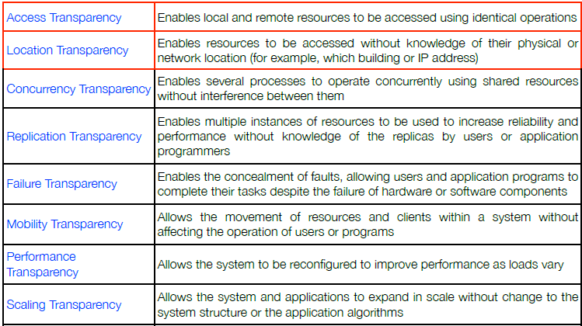
The 8 forms of transparency

Slide 21
Topic 2
Architectural Models
Material from:
http://eb.njit.edu/~gblank/cis633/

Slide 22
Modeling
Modeling is based on abstraction. We ignore some parts and details of a system to concentrate on others.

Slide 23
Questions for a model
What are the main entities in a system?
How do those entities interact with each other?
What characteristics affect the individual and collective behavior of those entities?

Slide 24
Purpose of a Model
Make explicit all of the relevant * assumptions about a system.
Make generalizations about what is possible or impossible to accomplish based on those assumptions.
Note that it is a real challenge to include everything that matters while excluding everything that does not matter!

Slide 25
What is the Architecture Analogy?
Just as we need many views to construct a house, (site plan, floor plans, wiring and plumbing diagrams, etc.) software development benefits from a similar approach
Time tested designs, methods, and approaches improve quality and performance
Architecture helps us understand the system, organize development, foster reuse, and evolve the system

Slide 26
Architectural Modeling
Architecture details a system by the organization of its components.
The components might be nodes on a network, layers of software, collections of services, or other ways of partitioning the system.
For example, one way of partitioning a system is to classify processes as client processes, server processes or peer processes.

Slide 27
Architectural Models
In complex systems, it is necessary to organize the complexity by partitioning.
Architectural models are ways to organize the parts and structure the relationships between them.
Two fundamental architectural models:
The Client/Server model
The Peer-to-Peer model

Slide 28
The Client/Server Model
The client/server model is organized around clients that request services and servers that provide services.
Services might include information (such as the current weather) or computational services (such as complex calculations).
There may be intermediate layers between the client and server that perform a portion of the task locating and providing services.

Slide 29
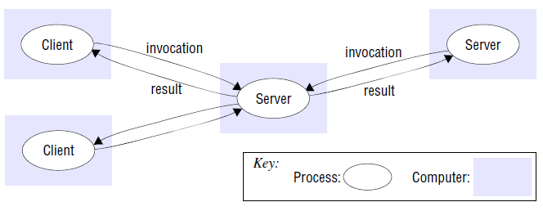
The Client/Server Model

Slide 30
Service Placement
Performance, scalability and mobility of the client/server model can be improved by
Partitioning or replicating data on servers
Caching data at proxy servers or clients
Using mobile code and mobile agents (code & data)
mobile agents can install and maintain software on computers
compare prices of products from vendors by visiting each vendor’s site and performing a series of database operations.

Slide 31
Service Placement
Multiple servers: Services with large demands, such as search engines, may have many servers dedicated to a particular task.
Proxy servers and Caches: Data likely to be needed again may be stored in memory or on local server for fast retrieval.
Mobile code: Code may be retrieved from a server for execution on a client system. A common example of this is a Java Applet.

Slide 32
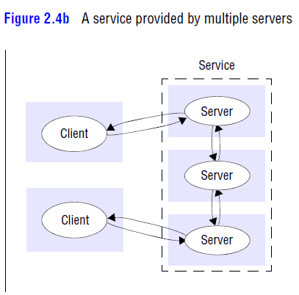
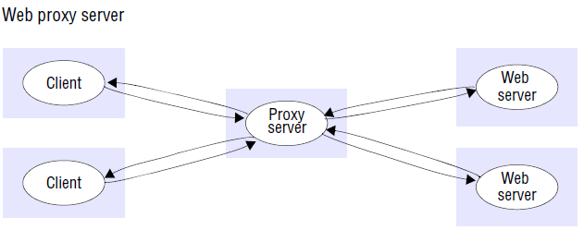
Service Placement

Slide 33
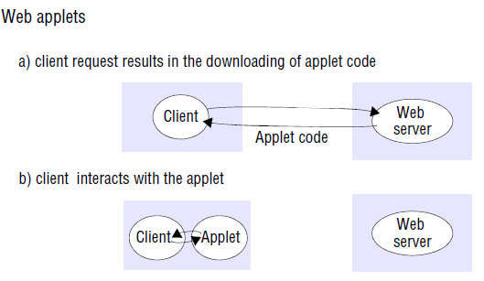
Service Placement

Slide 34
The Peer-to-Peer Model
In peer-to-peer models, each node of a distributed system is capable of requesting and providing services.
Most of the services are available from several or even many nodes.
Nodes tend to come and go from the network frequently, but redundancy tends to keep most services available.

Slide 35
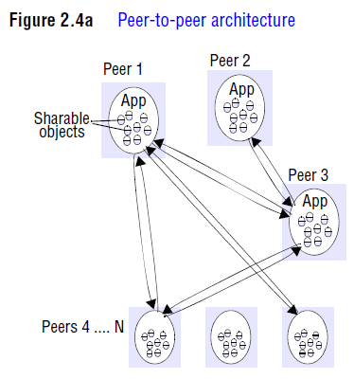
The Peer-to-Peer Model

Slide 36
Architectural Views
System Architecture
Application Architecture
Business Architecture
Presentation
Layer
Business
Application
Layer
Product
Information
Layer
Service
Resource
Support
Physical Architecture
Operations Architecture

Slide 37
Some Client/Server Architectural Patterns
Thin-Client model: All application processing and data management by server only.
Thick-Client model : Server only responsible for data management. The client machine implements application logic and interactions with user.
Three-tier client-server: There is a layer between client and server that may provide data and/or application processing.
Notes:
Thanks to Nick Panagopolis for the slides on Client Server Configurations

Slide 38
Thin or Thick Client? Thin
Pros
• Access to legacy systems
• System management and administration
from admin perspective: system maintenance, security
from user perspective: not hassle with administrative aspects or constant upgrades
More security
Green IT (power saving --> cost saving)

Slide 39
Thin or Thick? Thin
Cons
Heavy processing load on both server and network (bottleneck)
Less client-perceived performance (in highly interactive graphical activities such as CAD and image processing)
Need to be always connected

Slide 40
Thin or Thick? Thick
Pros
• Better client-perceived performance (especially, in terms of image & video processing)
• (Partly) available oﬄine
• Distributed computing (no single point of failures)
• Devices are becoming ever faster and cheaper:
what is the point of oﬀ-loading computation on a server when the client is capable of performing it without burdening the server or forcing the user to deal with network latencies?

Slide 41
Thin or Thick? Thick
Cons
System management and related costs
Having more functionality on the client makes client-side software more prone to errors and more dependent on the client’s underlying platform

Slide 42
Client/Server Configurations I
Client-Server configurations are generally categorized in two types:
Two-tier Configurations: consisting of a client and a server.
Client
(e.g. User
Interface)
Server
(e.g. Data)
Notes:
Thanks to Nick Panagopolis for the slides on Client Server Configurations

Slide 43
Client/Server Configurations II
Three-tier Configurations: includes another server that offloads certain functions from either the client and/or the server. Since there can be many intermediate servers, this may also be called n-tier.
Client
(e.g. User
Interface)
Mid-tier
for processing
Server
(e.g. Data)

Slide 44
Client/Server Configurations III
N-Tier Configurations: a type of three-tier set up that includes multiple intermediate servers.
Client
Mid-tier
Server
(e.g. Data)
Mid-tier
Client
Mid-tier
Processing can occur on any intermediate node using a three-tier configuration.

Slide 45
Typical Layers in a Distributed System
Applications and Services
Middleware
Operating System
Computer and Network Hardware

Slide 46
Multi-tier client-server
Presentation
Data management
Application processing
Client
Client
(browser)
Client
HTTP
Web Server(s)
CGI
Intranet
Database Server
ASP
CF
WS
Internet
ODBC
HTTP
Client
ODBC-Open Database Connectivity
CGI – Common Gateway Interface
ASP –Active server pages (Microsoft)
CF - Cold Fusion (Allaire Corp.)
Web Sphere – (IBM Corp.)
Client
Fire Wall
(security)
Client
(browser)

Slide 47
Use Cases of Client–Server Architectural Patterns
Two-tier client-server architecture with thin clients
• Legacy system applications that are used when separating application processing and data
management is impractical; clients may access these as services.
• Computationally intensive applications such as compilers with little or no data management
• Data-intensive applications (browsing and querying) with non-intensive application
processing (example: browsing the Web)
Two-tier client-server architecture with thick/fat clients
• Applications where application processing is provided by oﬀ-the-shelf software (e.g.,
Microsoft Excel) on the client
• Applications where computationally intensive processing of data (e.g., data visualization) is
required
• Mobile applications where internet connectivity cannot be guaranteed
• Some local processing using cached information from the database is therefore possible
Multi-tier client-server architecture
• Large-scale applications with hundreds or thousands of clients
• Applications where data from multiple sources are integrated

Slide 48
Topic 3
Case Study: Client-Server System for Banking

Slide 49
Problem: Design of a Client-Server System
• Input: an informal description of an application (e.g., banking application)
Presentation
Application
processing
Data
management
concerned with user interface
concerned with the detailed application-speciﬁc
processing associated with the application
concerned with the persistent storage of the application (typically a DBMS)
• Output: client-server implementation of the application

Slide 50

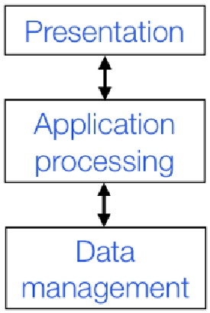
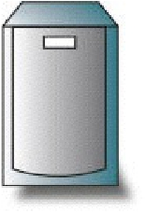
Solution 1: Two-Tier Client-Server Architecture
• Application organized as a server and a set of clients
• Two kinds of machines: client machines and server machines
how to map
3 application layers
into a 2-tier architecture?

Slide 51
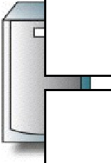

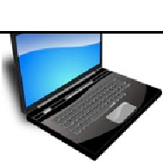
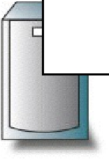


Thin VS Thick Client Model
Presentation
Presentation
Application
processing
Application
processing
Data
management
Data
management
Thin
Client
Thick
Client

Slide 52
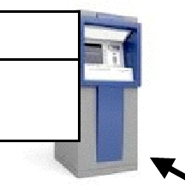
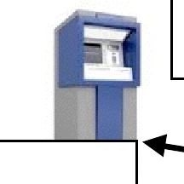
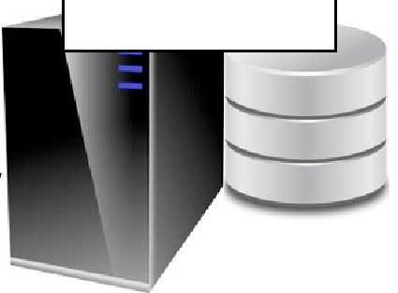
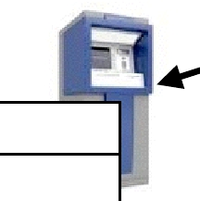
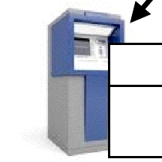
Example of Thick Client: ATM Banking System
Presentation
ATM client
Application
processing
Customer Account Server
Data management
Presentation
Application
processing
Presentation
Application
processing
account
database
Transaction
manager
Presentation
Application
processing

Slide 53
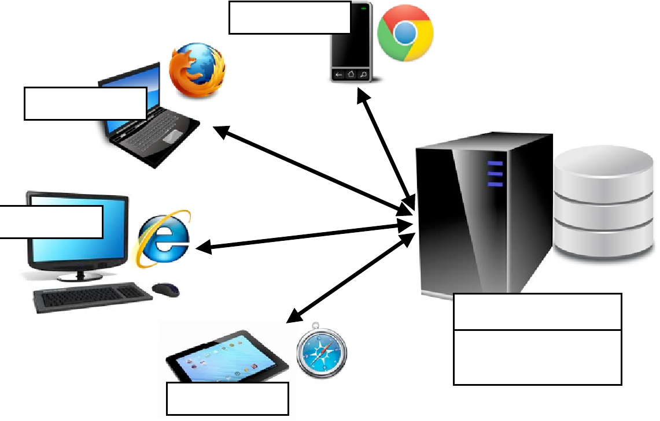
Examples of Thin Client: Internet Banking System
Presentation
client (Web browser)
Presentation
Customer Account Server
HTTP
Account
service
provision
account
database
Presentation
(Web server)
Data management
Application
processing
Presentation

Slide 54
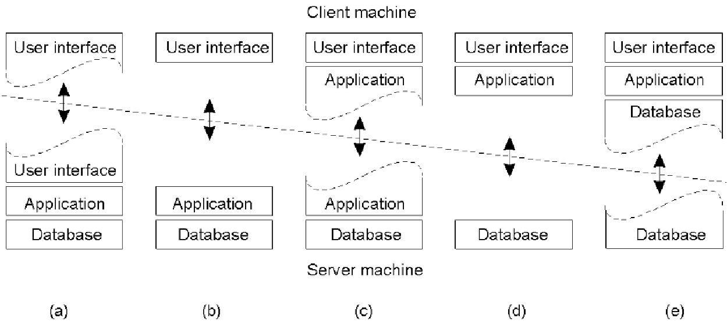



Alternative Two-Tier Client Server Organizations
terminals Web apps
Cloud computing
Thin Client
mobile games
word processor
Hybrid Client
mobile computing
Thick Client

Slide 55
Topic 4
Fundamental Models

Slide 56
Fundamental Models
Fundamental models describe properties common to all architectural models often focusing on communications between nodes
The interaction model manages performance and time limits
The failure model specifies faults and defines reliable communication
The security model describes threats to processes and communication channels

Slide 57
Interaction Model Concerns
Performance of communication channels
Computer clocks and timing events
Synchronous distributed systems
Asynchronous distributed systems
Event ordering

Slide 58
Failure Model Concerns
Failure model:
Defines the ways in which failures may occur
Provides an understanding of the effects of failures
Example of taxonomy of failures [Hadzilacos and Toueg, 1994]:
Omission failures: a process or communication channel fails to perform actions that it is supposed to do
Arbitrary failures: any type of error may occur
Timing failures: applicable in synchronous distributed systems.

Slide 59
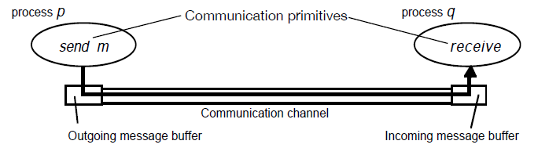
Processes and channels

Slide 60
Omission and Arbitrary Failures
Class of failure | Affects | Description
Fail-stop | Process | Process halts and remains halted. Other processes may detect this state.
Crash | Process | Process halts and remains halted. Other processes may not be able to detect this state.
Omission | Channel | A message inserted in an outgoing message buffer never arrives at the other end’s incoming message buffer.
Send-omission | Process | A process completes a send but the message is not put in its outgoing message buffer.
Receive-omission | Process | A message is put in a process’s incoming message buffer, but that process does not receive it.
Arbitrary (Byzantine) | Process or Channel | Process/channel exhibits arbitrary behavior: a process may set wrong values in its data items, or it may return a wrong value in response to an invocation, message contents may be corrupted, nonexistent messages may be delivered or real messages may be delivered more than once.

Slide 61
Timing Failures
Applicable in synchronous distributed systems
Class of Failure | Affects | Description
Clock | Process | Process’s local clock exceeds the bounds on its rate of drift from real time.
Performance | Process | Process exceeds the bounds on the interval between two steps.
Performance | Channel | A message’s transmission takes longer than the stated bound.

Slide 62
Security Model Concerns
Protecting objects
Securing processes and their communications
Defeating security threats
Cryptography and shared secrets
Authentication and Authorization
Secure channels
Denial of service
Mobile code

Slide 63
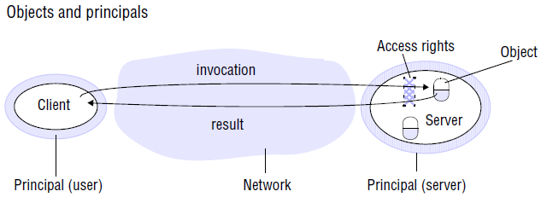
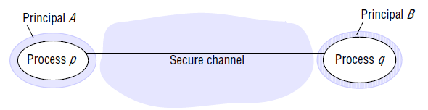
Security Model Concerns

Slide 64
Topic 5
Design Requirements

Slide 65
Design Requirements
There are many challenges in designing computer systems. Some of those challenges include:
Performance
Quality of service
Caching and Replication

Slide 66
Performance issues
Responsiveness: Users want both speed and consistency.
Throughput: IT systems are expensive, and are often sold on the basis of their ability to perform the most work for the least money.
Load balancing: High potential throughput can be defeated if the work is not distributed to make maximum use of potential because some of the system is idle.

Slide 67
Quality of Service
Design Requirements
Performance is one aspect of quality of service. Others include:
Reliability: this includes availability (“uptime”) and freedom from errors.
Security: this is protection from compromise or loss of information or investment.
Time Criticality: some information must be available in the right place at the right time. This is a major concern in designing networks.

Slide 68
Caching and Replication
Design Requirements
One tool for increasing throughput, availability and time critical sensitivity is storing extra copies of data in memory (caching) or on a local disk (replication).
Data stored can be small (translated web addresses) or large (multiple copies of corporate databases).
There are many challenges in managing data that can be changed in one place while having copies in other places.

Slide 69
References
George Coularis, Jean Dollimore and Tim Kindberg, Distributed Systems, Concepts and Design, Addison Wesley, Fifth Edition, 2011. Chapter 2 Andrew Tannenbaum and Maarten Steen, Distributed Systems, Principles and Paradigms, Prentice Hall, 2007. Chapter 2

Slide 70
Thank you for
your attention.

